Slide 1
Big Data Processing
using
Cloud-based Workflows
Mahdi Ebrahimi
Department of Computer Science
mahdi.ebrahimi@csun.edu
Notes:
1

Slide 2
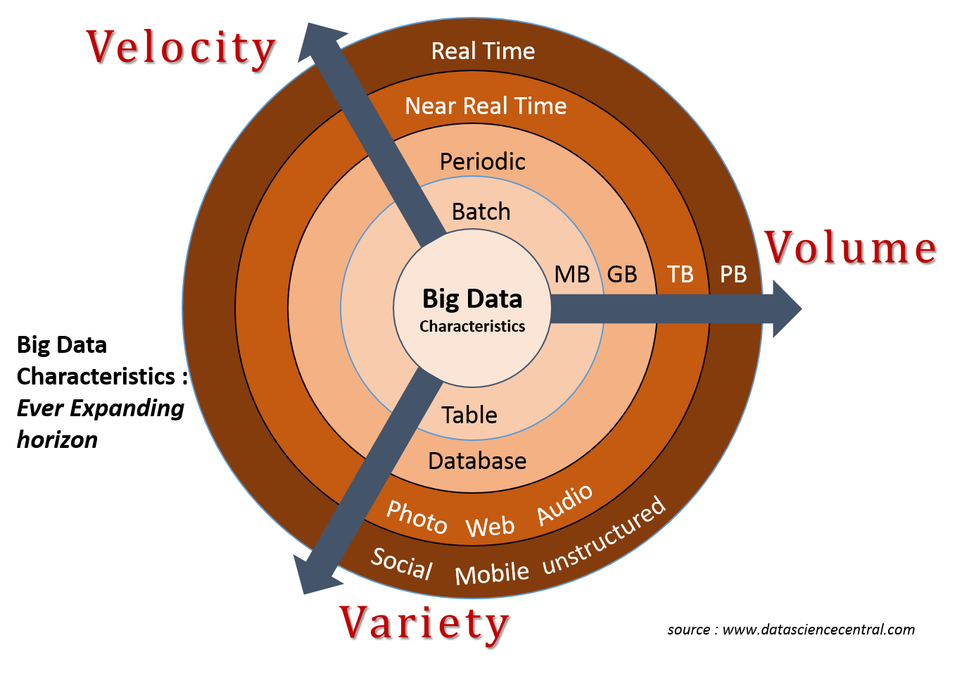
Characteristics of Big Data

Slide 3
Very Large Storage Requirements
Facebook has Hadoop clusters with 15 PB of raw storage (15,000,000 GB).
No single storage can handle this amount of data.
We need a large set of nodes each storing part of the data.
Notes:
scale up vs scale out

Slide 4

Big Data and Cloud Computing
Cloud computing provides almost unlimited storage and computing capacities for big data analytics. However, it remains tremendously difficult to use the cloud for big data.
Challenges:
1- Low-level programming: The user needs to code their data analytics software with many considerations of low-level cloud and virtual machine details.
2- Performance tuning: The cost, performance, and configuration of different virtual machines vary and it is always costing and time consuming to tune the performance of a cloud-based big data analytics application to satisfy a user’s QoS parameters such as monetary budget and deadline.
Big data workflow techniques address these challenges and fill the gap between cloud computing and big data management and analytics.

Slide 5
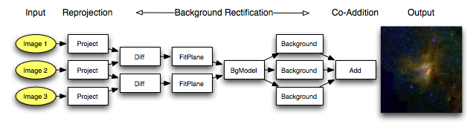
What is a workflow?
1- A software program that consists of multiple computation tasks that are connected together as a DAG (Directed Acyclic Graph).
2- Each task is functional computation unit that includes a set of input ports and output ports.
Goal: automate a scientist’s data analysis tasks.
Notes:
big data analytics and workflow process automation

Slide 6
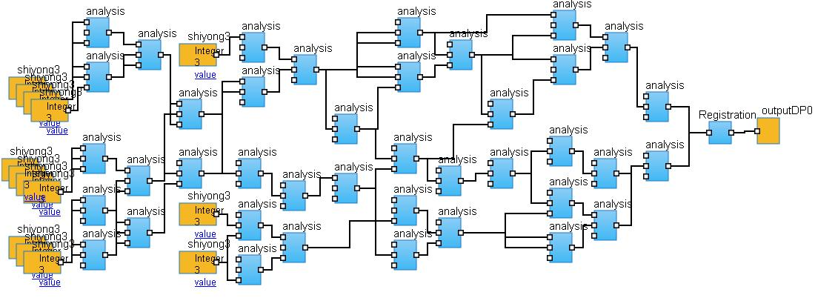
Why big data workflows?
1- Writing a task is simple.
2- Composing a workflow is simple.
3- A big data workflow can easily run in the cloud to achieve high scalability and performance with low cost.

Slide 7
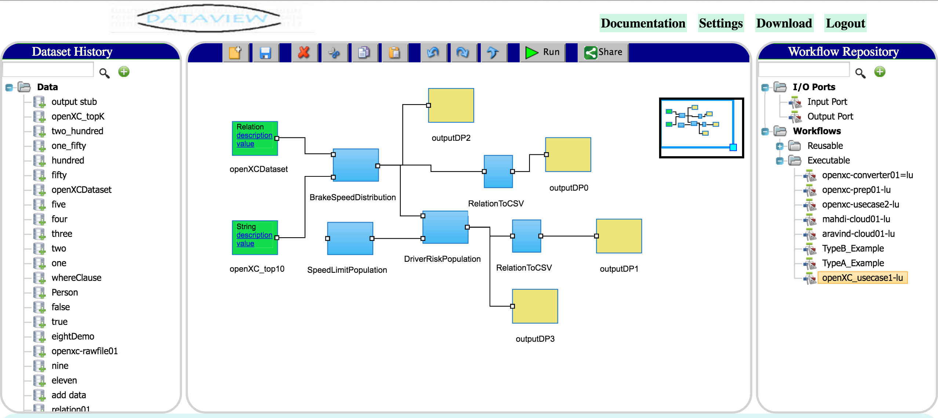
Workflow Management System
It manages all the details of cloud to run the workflows in the cloud. Details like:
How many cloud VMs? Which VM to run which task? Transfer code (task) and data from one VM to another VM.

Slide 8
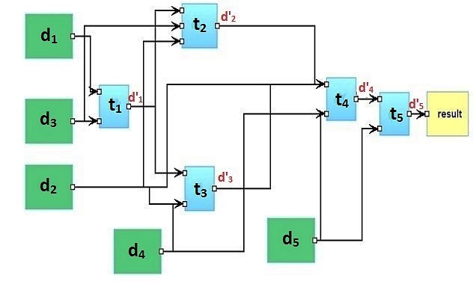
Big Data Workflow
Big data workflow is the computerized modeling and automation of a process consisting of a set of computational tasks and their data interdependencies to process and analyze data of ever increasing in scale, complexity, and rate of acquisition.
Goals: automate a scientist’s data analysis tasks.
Various data-intensive scientific areas such as bioinformatics, physics, astronomy, ecology and earthquake science.
Modeled as directed acyclic graphs (DAGs):
workflow tasks graph nodes
data flow among tasks graph vertices
direction of vertices flow of data to tasks
Notes:
8

Slide 9

Big Data Workflows Scheduling in the Cloud
Challenges & Opportunities:
Unbounded number of virtual machines.
Homogeneous and Heterogeneous machine types.
Schedule which task on which machine and when.
Goal: To minimize the workflow makespan or execution cost.
Notes:
9
NP Class of computational decision problems for which a given yes-solution can be verified as a solution in polynomial time by a deterministic Turing machine (or solvable by a non-deterministic Turing machine in polynomial time).
NP-hard Class of decision problems which are at least as hard as the hardest problems in NP. Problems that are NP-hard do not have to be elements of NP; indeed, they may not even be decidable.

Slide 10
Four decisions made by workflow scheduling algorithm
1) Virtual machine provisioning and deprovisioning:
How many VMs do we need and what types?
When do we need to provision and deprovision these VMs?
2) Task mapping:
On which VM should a workflow task T be running?
3) Task scheduling:
When to run T on VM after task T is mapped to VM?
4) Data transfer scheduling:
When a dataset D needs to move from one VM to another?
Notes:
NP Class of computational decision problems for which a given yes-solution can be verified as a solution in polynomial time by a deterministic Turing machine (or solvable by a non-deterministic Turing machine in polynomial time).
NP-hard Class of decision problems which are at least as hard as the hardest problems in NP. Problems that are NP-hard do not have to be elements of NP; indeed, they may not even be decidable.

Slide 11
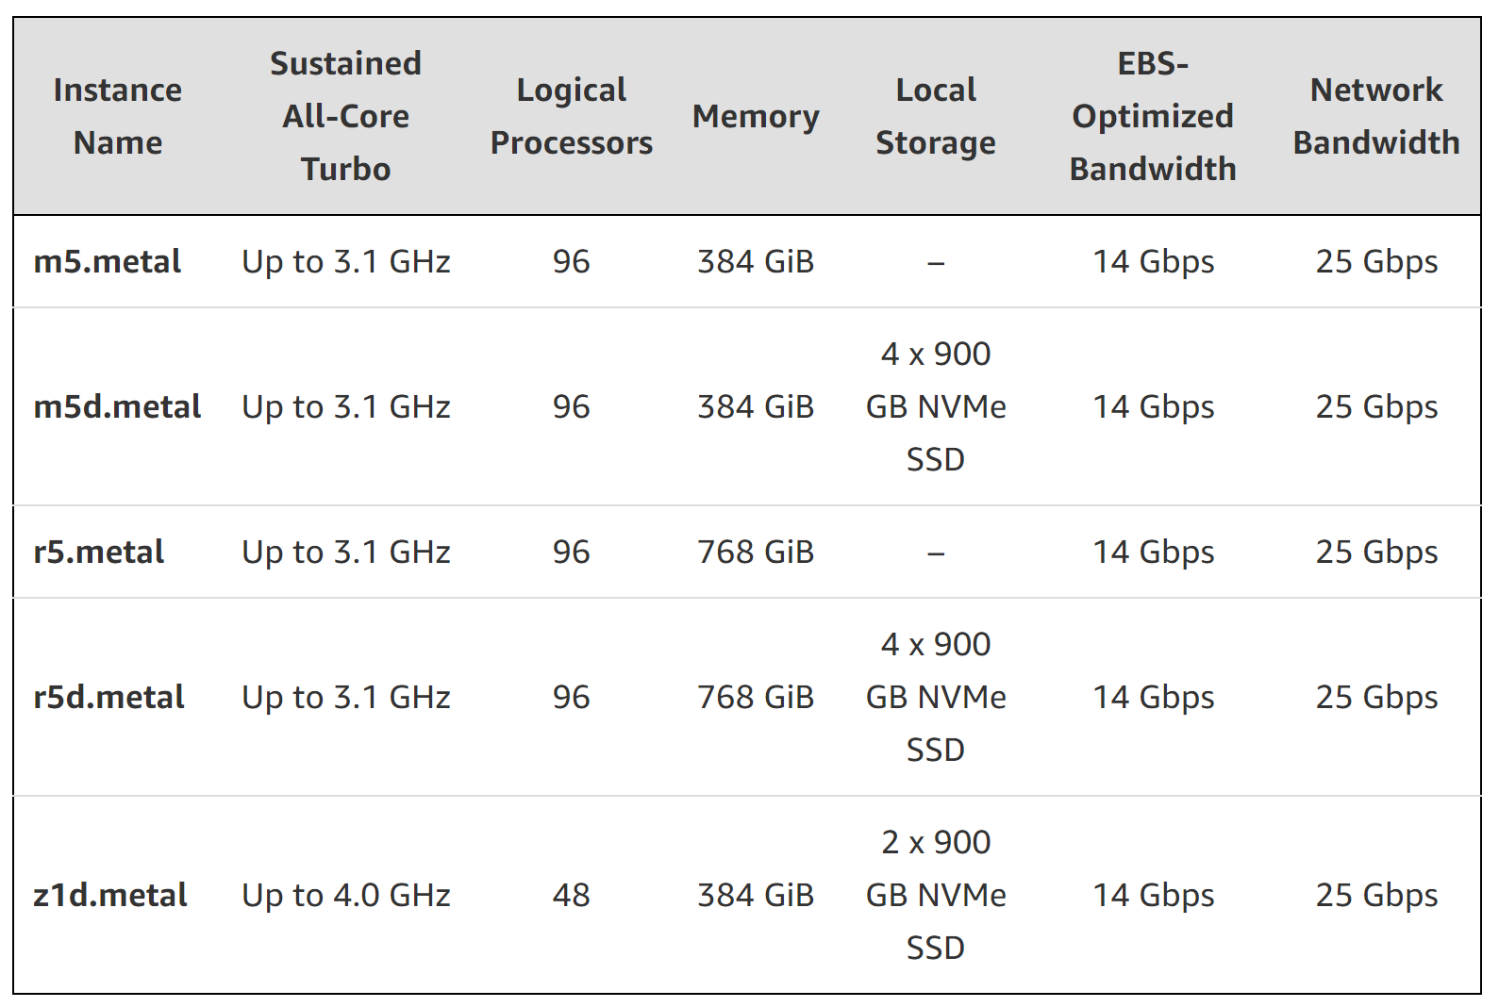
Amazon EC2 virtual Machine Types
https://aws.amazon.com/ec2/instance-types/#instance-details

Slide 12
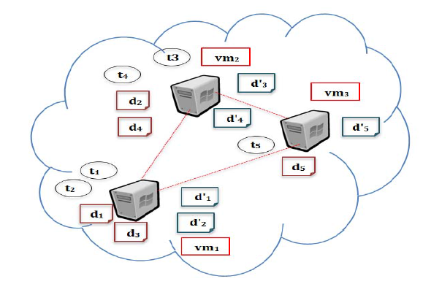
Big DAta Placement (BDAP)
Job Shop Scheduling
Job shop scheduling: given n jobs J₁, J₂, ..., J_{n} of varying sizes, which need to be scheduled on m identical machines, while trying to minimize the makespan (total execution time).
Job Shop Scheduling is NP-hard. ( https://www.youtube.com/watch?v=e2cF8a5aAhE )
Example:
Notes:
12
Polynomial time vs Exponential time
O(n^2) is polynomial time. On the other hand, O(2^n) is exponential time
NP (Non-deterministic polynomial time) vs P (deterministic polynomial time)
NP -> non-deterministic polynomial time = deterministic exponential time
Job scheduling is the process of allocating system resources to many different tasks by an operating system (OS).

Slide 13
Workflow Task Scheduling
A standard representation of the solution is as an array of integer numbers (1, 2, 3, 4, …) such that
Array index range = total number of workflow tasks
Array value range = total of available cloud virtual machines
Example: S = 23121
S(t₁) = vm₂ , S(t₂) = vm₃ , …
Total possible task scheduling (assignment) solutions = 3*3*3*3*3 = 3⁵ =243 !!! (5 tasks and 3 VMs)
t₁ | t₂ | t₃ | t₄ | t₅
2 | 3 | 1 | 2 | 1
Notes:
13
Polynomial time vs Exponential time
O(n^2) is polynomial time. On the other hand, O(2^n) is exponential time
NP (Non-deterministic polynomial time) vs P (deterministic polynomial time)
NP -> non-deterministic polynomial time = deterministic exponential time
Job scheduling is the process of allocating system resources to many different tasks by an operating system (OS).

Slide 14
Thank you.
Questions?
Notes:
14

